Slide 1

A Study On Imapact of
Artificial Intelligence in Digital Marketing
Leveraging Artificial Intelligence for Smarter Marketing Strategies
By
U.GIRIDHAR KARTHIK
22924090003
GUIDE
PROF U.K.SHUKLA

Slide 2

INTRODUCTION
Digital marketing involves promoting products, services, or brands through digital channels like search engines, social media, email, and websites. It allows businesses to reach a global audience, target specific demographics, and measure campaign effectiveness in real-time. With the rise of the internet and mobile technology, digital marketing has become a cornerstone of modern business strategies.
The growing importance of AI in digital marketing lies in its ability to analyze vast amounts of data, automate tasks, and deliver personalized experiences. AI-driven tools can optimize ad targeting, improve customer engagement through chatbots, and enhance content creation by predicting what resonates with specific audiences. As AI continues to evolve, it enables more efficient and effective marketing strategies, helping businesses stay competitive in an increasingly digital world.

Slide 3
PURPOSE
The purpose of this presentation is to explore how AI is revolutionizing digital marketing and to examine its profound impact on businesses. We will delve into the various ways AI is being integrated into marketing strategies, from enhancing customer engagement to optimizing advertising and content creation.
By understanding these transformations, businesses can leverage AI to gain a competitive edge, improve efficiency, and deliver more personalized customer experiences. This presentation aims to provide insights into the current trends and future potential of AI in the digital marketing landscape.

Slide 4
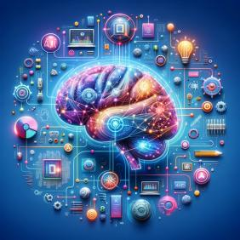
HISTORY OF
ARTIFICIAL INTELLIGENCE (AI)
The history of Artificial Intelligence (AI) began in the mid-20th century, but its roots trace back to early efforts in logic and reasoning by philosophers and mathematicians like Aristotle. The formal birth of AI as a field occurred in 1956 at the Dartmouth Conference, where pioneers like John McCarthy, Marvin Minsky, and others laid the foundation for creating machines capable of simulating human intelligence. Alan Turing’s earlier work, particularly his concept of the "Turing Machine" and the "Turing Test," also played a critical role in shaping early AI thought. These early developments led to the creation of AI programs like the "Logic Theorist" and "General Problem Solver," which attempted to mimic human reasoning and problem-solving abilities.

Slide 5
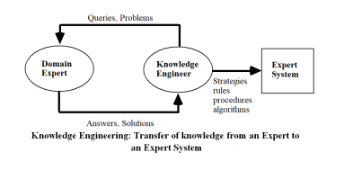
HISTORY OF
ARTIFICIAL INTELLIGENCE (AI)
In the 1960s, the field saw the development of LISP, a programming language specifically designed for AI, which remains influential to this day. Early optimism about AI’s potential was tempered by challenges in achieving truly "intelligent" machines, but these formative decades set the stage for later advancements. Though early AI struggled with computational limitations, the ideas and frameworks from this era have continued to evolve, leading to the sophisticated AI applications we see today in fields like digital marketing, automation, and machine learning.

Slide 6
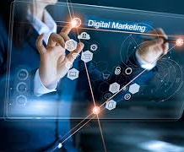
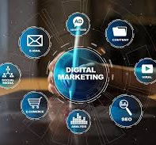
HISTORY OF
DIGITAL MARKETING
The history of digital marketing began with the rise of the internet and has evolved rapidly over the past few decades. In the early 1990s, the advent of the World Wide Web transformed how businesses could interact with consumers. The first digital ads, such as banner ads, appeared in 1994, and websites like Yahoo and Google soon became dominant forces, offering new opportunities for search engine marketing (SEM) and pay-per-click (PPC) advertising. Email marketing also gained popularity during this period, as companies began to send targeted promotional messages to consumers.

Slide 7
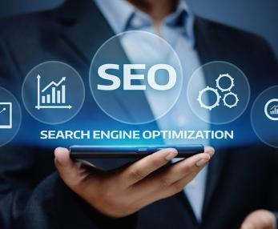
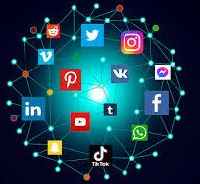
HISTORY OF
DIGITAL MARKETING
The 2000s marked a major turning point with the emergence of social media platforms like Facebook, YouTube, and Twitter, which revolutionized how businesses connected with audiences. Digital marketing evolved to include social media marketing, content marketing, and influencer collaborations. The introduction of smartphones further accelerated digital marketing's growth, enabling mobile marketing and location-based targeting. Over the years, digital marketing has continued to adapt with innovations in SEO, programmatic advertising, and artificial intelligence (AI), allowing marketers to target customers more precisely and personalize their experiences across multiple channels.

Slide 8
What is AI in Digital Marketing?
Definition: AI in digital marketing refers to the use of artificial intelligence technologies to automate, optimize, and enhance various marketing tasks and strategies. This includes leveraging machine learning, natural language processing, predictive analytics, and other AI-driven tools to analyze data, personalize customer experiences, automate repetitive tasks, and improve decision-making. By integrating AI, marketers can better understand consumer behavior, predict trends, and deliver more targeted and effective marketing campaigns.
Key Components:
Machine Learning
Natural Language Processing (NLP)
Data Analytics
Automation

Slide 9
AI-Driven Digital Marketing Tools
AI-driven digital marketing tools are software solutions that utilize artificial intelligence to automate, enhance, and optimize marketing activities. These tools help businesses improve efficiency, personalize customer interactions, and achieve better results. Some key AI-driven digital marketing tools include:
Chatbots and Virtual Assistants: AI-powered chatbots, like Drift or Intercom, provide instant customer support, engage with users, and guide them through their purchasing journey.
Email Marketing Automation: Tools like Mailchimp and HubSpot use AI to segment audience

Slide 10
Predictive Analytics Platforms: AI-driven platforms like Google Analytics and Piwik PRO predict customer behavior, helping marketers tailor their strategies based on data-driven insights.
Content Creation Tools: Tools like Jasper (formerly Jarvis) and Copy.ai use AI to generate content ideas, write articles, and create social media posts, saving time and ensuring consistency.
Ad Optimization Tools: AI tools like AdRoll and Smartly.io optimize digital advertising campaigns by analyzing performance data and automatically adjusting bids, budgets, and targeting for better ROI.
Social Media Management Tools: Tools like Hootsuite and Sprinklr use AI to schedule posts, analyze engagement, and provide insights into social media trends, helping businesses maintain a strong online presence.

Slide 11
RESEARCH DESIGN
Objective:
The primary objective of this research is to analyze how AI-driven tools and strategies have impacted digital marketing across different industries. The study aims to quantify the effects of AI on key marketing metrics such as revenue growth, customer engagement, and retention rates. By examining real-world examples, the research seeks to illustrate the tangible benefits and improvements companies have experienced after implementing AI technologies.
Methodology:
Data for this research was collected through a combination of secondary sources, including company reports, case studies, and industry analyses. The research involves a comparative analysis of pre- and post-AI implementation metrics for five prominent companies—Amazon, Netflix, Coca-Cola, Sephora, and Starbucks. Each company was selected based on their notable use of AI tools in digital marketing and their ability to provide detailed, quantifiable results.

Slide 12
DATA COLLECTION & ANALYSIS
Case Studies: In-depth case studies from company reports and industry publications were used to gather detailed information on AI tools, their applications, and their impacts on marketing metrics.
Company Reports: Official reports and press releases from companies such as Amazon, Netflix, Coca-Cola, Sephora, and Starbucks provided data on revenue, customer engagement, and other relevant metrics before and after AI implementation.
Industry Reports: Reports from sources like Gartner and McKinsey Digital offered additional context and comparative data to support the analysis of AI’s impact on marketing.
Data Analysis:
The collected data was analyzed to identify trends, patterns, and quantifiable impacts of AI on digital marketing. Metrics such as revenue from recommendations, customer engagement, and retention rates were examined to evaluate the effectiveness of AI tools.

Slide 13
TOOLS USED IN RESEARCH
Statistical Tools:
Percentage Calculations: Used to determine the proportionate impact of AI on marketing metrics, such as revenue growth and customer engagement rates.
Averages: Calculated to provide a baseline measure of typical marketing performance before and after AI implementation.
Column Charts: Employed to visually compare key metrics (e.g., revenue from recommendations) before and after AI across different companies.
Data Visualization:
Bar Graphs: Illustrated the comparative revenue growth from recommendations for companies like Amazon and Netflix, highlighting the percentage increase in revenue attributed to AI-driven recommendations.
Pie Charts: Displayed the percentage increase in customer engagement for companies like Coca-Cola and Starbucks, showing the proportionate growth in engagement before and after AI implementation.

Slide 14
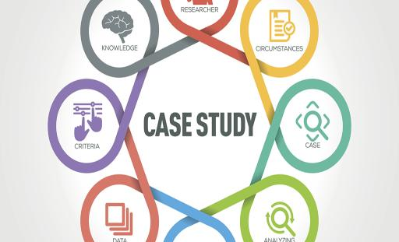
CASE STUDIES OF
COMPANIES USING AI IN DIGITAL MARKETING
Amazon
Netflix
Coca-Cola
Sephora
Starbucks

Slide 15

1. AMAZON
AI Tool Used By Amazon:
Amazon Machine Learning (AML) and Personalization Algorithms
AI Work:
Amazon uses AI primarily for product recommendations, improving customer experiences through personalized suggestions, and automating its marketing campaigns. The AI system analyzes purchasing behavior, browsing patterns, and customer preferences.

Slide 16
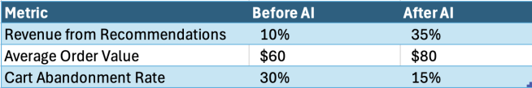
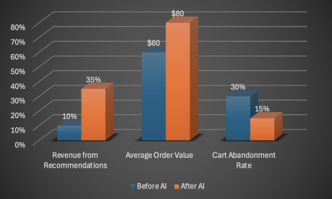
DATA ANALYSIS
Growth Before AI:
Relied on traditional product listings and basic ad targeting for sales growth.
Growth After AI:
35% of Amazon's revenue is attributed to AI-driven recommendations.
Increased customer retention and average order value.
Reduction in cart abandonment rates.

Slide 17

2. NETFLIX
AI Tool:
Machine Learning for Recommendation Systems and Deep Learning for Personalization
AI Work:
Netflix uses AI to recommend content based on user viewing history, preferences, and behaviors. Their predictive algorithms also help in determining the best content to produce.

Slide 18
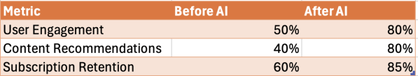
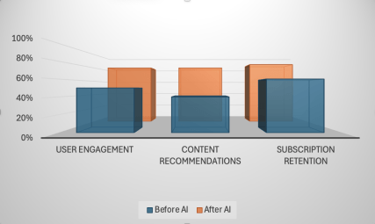
DATA ANALYSIS
Growth Before AI:
Content recommendations were basic, without the use of machine learning, leading to lower user engagement.
Growth After AI:
80% of Netflix views come from AI-driven recommendations.
Significant increase in user engagement and subscription retention.

Slide 19
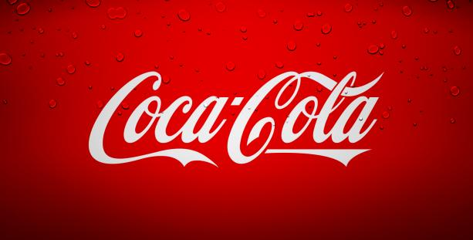
3. Coca-Cola
AI Tool:
AI-powered Predictive Analytics for Social Media Marketing and Chatbots
AI Work:
Coca-Cola uses AI for predictive analytics, allowing them to forecast customer behavior, optimize ad placement, and personalize content. Their AI chatbots engage with consumers via social media platforms, enhancing customer service.

Slide 20
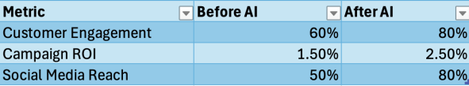
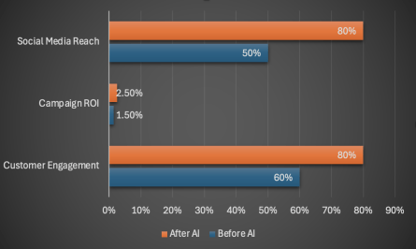
DATA ANALYSIS
Growth Before AI:
Traditional social media ads and content marketing with limited targeting capabilities.
Growth After AI:
Improved customer engagement by 20% through personalized ads.
Enhanced campaign ROI through better targeting.

Slide 21

4. SEPHORA
AI Tool:
Virtual Try-On AI (Sephora Virtual Artist) and Chatbots
AI Work:
Sephora’s AI tools allow customers to try on makeup virtually, providing personalized beauty recommendations. They also use AI chatbots to assist customers with product inquiries and personalized advice.

Slide 22

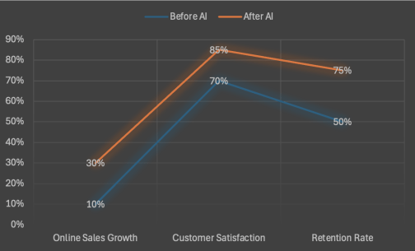
DATA ANALYSIS
Growth Before AI:
Relied heavily on in-store interactions and non-personalized online shopping experiences.
Growth After AI:
Increased online sales by 30% due to personalized virtual experiences.
Customer satisfaction and retention rates increased significantly.

Slide 23

5. STARBUCKS
AI Tool:
Deep Brew (AI-powered personal assistant for order personalization)
AI Work:
Starbucks leverages AI to analyze customer preferences, providing personalized recommendations and promotions through their app. The AI system helps to automate marketing strategies and forecast demand based on customer data.

Slide 24

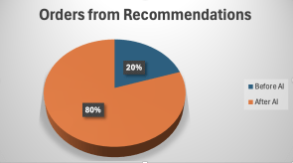
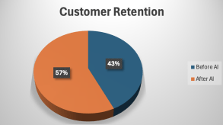
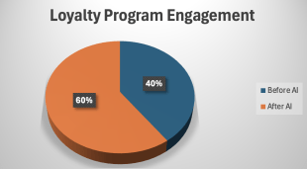
DATA ANALYSIS
Growth Before AI:
Focused on in-store promotions and standard loyalty programs with limited personalization.
Growth After AI:
40% of Starbucks orders are now placed via AI-powered mobile app recommendations.
Increased customer retention and loyalty program engagement.

Slide 25
Benefits of AI in Digital Marketing
Improved Customer Experience: Personalization and faster response times.
Efficiency: Automation of repetitive tasks like email marketing and ad placements.
Data-Driven Decisions: Enhanced analytics for better decision-making.
Cost Savings: Reduced costs through automation and optimized ad spend.

Slide 26
Challenges of AI in Digital Marketing
Data Privacy Concerns: Handling of customer data and compliance with regulations like GDPR.
High Implementation Costs: Investment in AI technology and expertise.
Over-reliance on Automation: The risk of losing the human touch in marketing strategies.

Slide 27
Conclusion
AI's role in enhancing personalization, efficiency, and data-driven decision-making in digital marketing.
Emphasize the potential of AI to revolutionize the marketing landscape and the importance of staying updated with AI trends.

Slide 28
BIBLIOGRAPHY
REFERENCE:
https://www.gartner.com/en/marketing/topics/ai-in-marketing
https://www.mckinsey.com/capabilities/mckinsey-digital/case-studies
BOOKS:
“Artificial Intelligence in Marketing" by Kunal Gaurav – Discusses the rise of AI in various marketing strategies
“AI for Marketing and Product Innovation" by A.K. Pradeep – Covers real-world case studies of AI in marketing.

Slide 29
BIBLIOGRAPHY
WEBSITES:
https://aws.amazon.com/ai/machine-learning/
https://netflixtechblog.com/evolving-from-rule-based-classifier-machine-learning-powered-auto-remediation-in-netflix-data-039d5efd115b
https://stories.starbucks.com/search/AI/

Slide 30
THANK YOU

